Slide 1
Lambda Functions
Notes:
Are your classroom colors different than what you see in this template? That’s OK! Click on Design -> Variants (the down arrow) -> Pick the color scheme that works for you!
Feel free to change any “You will…” and “I will…” statements to ensure they align with your classroom procedures and rules!

Slide 2
What is it?!
What is a lambda function | Limitations:
Lambdas are pythons way of creating anonymous functions. They are functions without a name, simple and short lived so worth writing the function in one line. | Lambdas cannot have default parameters Can’t contain complex logic

Slide 3
Syntax Let’s put it down simply:
f = lambda x , y : x + y
Everything after the colon is what should be done with the parameters
The word lambda says this is an anonymous function
Everything before the colon are the parameters

Slide 4
Regular Function Vs. Lambda Function
regular function
def sum_nums(x,y):
f = x+y
return f
lambda function
lambda x,y: x + y

Slide 5
Pros and Cons
Pros | Cons
Good for simple logical operations that are easy to understand. This makes the code more readable too. Good when you want a function that you will use just one time. | They can only perform one expression. It’s not possible to have multiple independent operations in one lambda function. Bad for operations that would span more than one line in a normal def function (For example nested conditional operations).

Slide 6
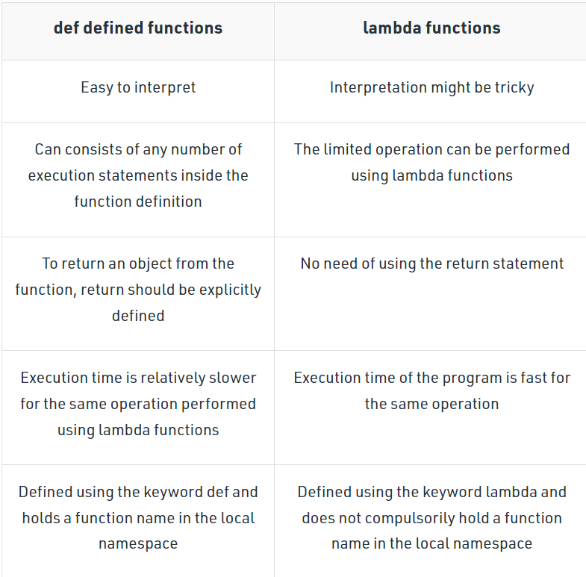
Table of Differences

Slide 7
Conditional Statements
If – Else – Nested If Else (elif)

Slide 8
Using if-else in lambda function
When using lambda with if-else conditions in Python, here is the following general syntax:
lambda <arguments> : <statement1> if <condition> else <statement2>
Here, the lambda function will return statement1 when if the condition is true and return statement2 when if the condition is false
Example:
conditional = lambda a: a/10 if a < 20 else a

Slide 9
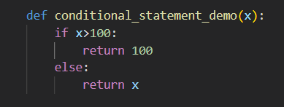

Def Vs. Lambda (if-else)

Slide 10
Using if else & elif in lambda function
We can also use nested if, if-else in lambda function. Here is the following general syntax:
lambda <arguments> : <statement1> if <condition > ( <statement2> if <condition> else <statement3>)
Here, statement1 will be returned when if the condition is true, statement2 will be returned when elif true, and statement3 will be returned when else is executed.
Example:
conditional = lambda a: a/10 if a > 20 else (a*a if a>10 else a)

Slide 11
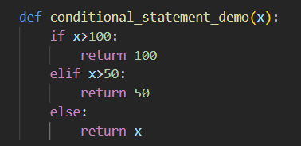

Def Vs. Lambda (if-else-elif)

Slide 12
WHEN TO USE LAMBDA FUNCTIONS
Scalar values – Lists – Series - Dataframe

Slide 13
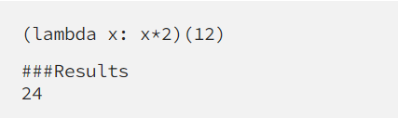
1. Scalar Values
This is when you execute a lambda function on simple logic.
In the code above, the function was created and then immediately executed.

Slide 14
2. Iterables
In python, iterables include strings, lists, dictionaries, ranges, tuples, and so on.
When working with iterables, you can use lambda functions in conjunction with two common higher order functions: filter() and map() .

Slide 15
3. Pandas Series or Dataframe
Lambdas are also useful on a Pandas series. A series is a data frame column. You can manipulate all of the values in a series by using the lambda function.
When working with pandas series, you can use lambda functions in conjunction with two common higher order functions: apply() and map() .

Slide 16
Lambdas with Higher-order Functions
We use lambda functions a lot with python classes that take in a function as an argument, for example, map() and filter().
Filter() | Map() | Apply()
When using lambda functions on a list or iterable. | When using lambda functions on a list or iterable. | When using a lambda function on a series or dataframe object.

Slide 17
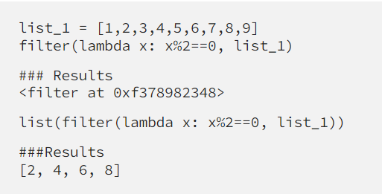
Filter()
We use filter() when we want to focus on specific values in an iterable. It filters out the values we want from a list or iterable based on the function we pass in
Syntax:
filter(function, iterable)
The iterable can be any sequence such as a list, set, or series object
This example filters a list for even numbers

Slide 18
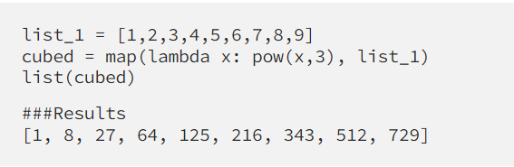
Map()
You use map() when you want to modify every value in an iterable or Pandas series.
Syntax:
map(function, iterable)
This example cubes every number in the list

Slide 19
Apply()
You use apply() when you want to modify every value in a Pandas series.
Syntax:
apply(function, iterable)

Slide 20
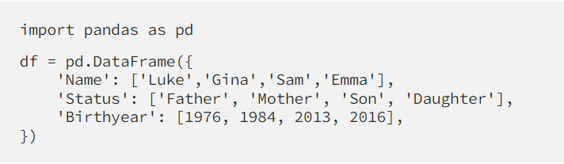
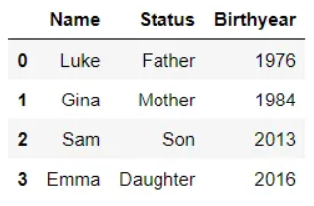
Example: Lambda with Appy() on a series object
Let’s create a dummy dataframe about family members

Slide 21

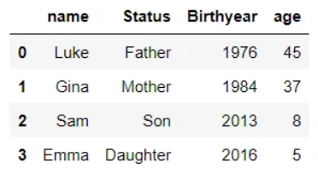
Create a new column age with the age of all family members in the year 2021.

Slide 22
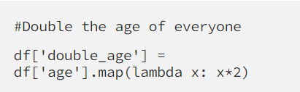
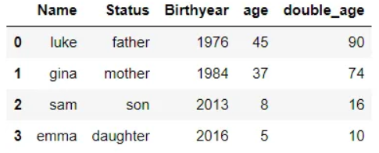
Example: Lambda with map() on a series object
Map works very much like apply() in that it modifies values of a column based on the expression.
.

